Slide 1
Computer Vision

Slide 2
Computer Vision & Deep Convolutional Neural Nets
Self-driving cars
Face recognition
Deep Learning in Art?
Brand new applications every year

Slide 3
Computer vision problems
Image classification
Object detection > Multiple object
Neural Style Transfer
Segmentation

Slide 4
Computer vision challenges
Very large inputs
For example an RGB picture of 64x64 has 12288 inputs, this is a small image
What about 1000x1000 picture (1 megapixel)? 3 million inputs
In a fully connected layer with a 1000 neurons in the first layer, w1 will be (1000,3M) -> 3 billion parameters. This will cause several problems such as overfitting, computational requirements and memory requirements
This is why we use the convolutional operation

Slide 5
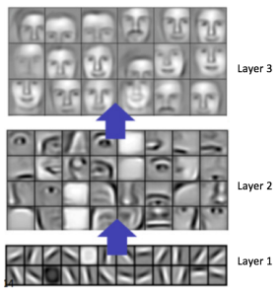
Edge detector

Slide 6
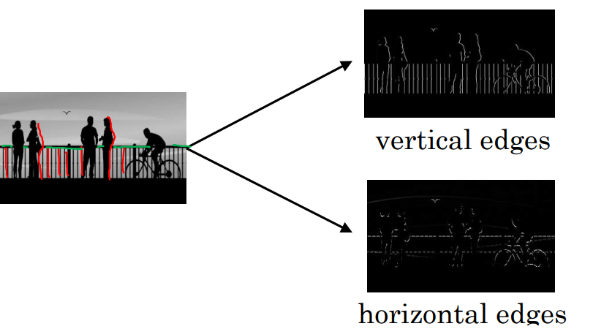
Edge detector

Slide 7
Vertical Edge Example
Teken 6x6 * 3x3 geeft 4x4 -> 6x6 is random, 3x3 is [[1,0,-1],[1,0,-1],[1,0,-1]]. Laat zien hoe convolution werkt
Teken nu 6x6 met links allemaal 10 en rechts allemaal 0. Laat zien dat er een vertical edge wordt gevonden
Computer vision is zelf proberen slimme gewichten te designen
Deep Learning bedenkt ze zelf

Slide 8
https://www.tensorflow.org/tutorials/images/cnn
https://www.tensorflow.org/tutorials/images/classification

Slide 9
Padding
Shrinking output
Buitenste pixels krijgen weinig aandacht, weggooien van informatie
Voor de convolutional operation, pad the image, randje eromheen
6x6 wordt met extra rand 8x8, convolve met 3x3 wordt weer 6x6

